Slide 1


Privacy Law Update
Frederic M. Wilf
Joshua D. Waterston
Wilftek LLC
Trenton Computer Festival
March 18, 2022

Slide 2
Overview
Fair Information Principles
Which law applies?
Outside of the US
European Union’s General Data Privacy Regulation (GDPR) and similar privacy laws
US federal laws
US state laws
California Consumer Privacy Act of 2018 (CCPA)
California Privacy Rights Act of 2020 (CPRA)
Other states’ laws
Security overview
Governance, Leadership and Management
Security Frameworks and Standards
Important takeaways

Slide 3
Timeline Identity Theft and Privacy Law
Biblical | Jacob pretends he’s Esau for fun and profit
1550s | “Martin Guerre” returns
1770s | Ben Franklin requires postal workers not to read letters
1890 | Newspapers, small cameras lead to Warren & Brandeis article: The Right to Privacy
1970s | Credit databases, fast networks lead to US Fair Credit Reporting Act and Fair Information Practice Principles
1986 | Email leads to US Electronic Communications Protection Act
1995 | EU Data Protection Directive (“Privacy Directive”)
1996 | Health Insurance Portability and Accountability Act (“HIPAA”)
2000s | California & other US states pass data breach notification acts
2009 | Health Info Tech for Economic and Clinical Health (“HITECH”) Act
2018 | EU General Data Protection Regulation (“GDPR”) takes effect
2018-23 | California Consumer Privacy Act, California Privacy Rights Act

Slide 4
Learn the Privacy Lingo
PII = Personally Identifiable Information = Personal Data
Information that identifies a specific individual
PHI = Protected Health Information
Information which identifies patient and is used/disclosed by a “covered entity” during the course of care
Data Subject = the individual whose PII is collected
SAR = Subject Access Request
GDPR term for exercising one’s rights to access, correct, or delete their PII
PIA = Pain in the Privacy Impact Assessment
An organization’s assessment of its privacy collection & protection practices
GDPR = General Data Protection Regulation
EU privacy law, currently the benchmark for privacy best practices. Affects most large businesses and even some small ones. And it has teeth…
DPO = Data Privacy Officer / Data Protection Officer
Point person for data privacy within organizations
DPA = Data Protection Authority
Governmental entity responsible for data privacy compliance within a jurisdiction
SCC = Standard Contractual Clauses
GDPR model contract clauses re: transferring PII out of the EU
ISO 27001 = privacy compliance certification
Demonstrates that organization follows best practices

Slide 5
Fair Information Principles
Catalyst: Creation of fast connections to large databases
Several formulations; this set mostly OECD: http://oecdprivacy.org/
Collection Limitation
Collection of personal data by lawful and fair means and, where appropriate, with the knowledge or consent of the data subject
Data Quality
Personal data should be relevant, accurate, complete and kept up-to-date
Purpose Specification
Purposes for collection should be specified and subsequent use limited to those purposes
Use Limitation
Personal data should not be disclosed, made available or used for other purposes, except with consent of data subject or by authority of law.

Slide 6
Fair Information Principles
Security Safeguards
Personal data protected by reasonable security safeguards
Openness
General policy of openness about developments, practices and policies with respect to personal data
Individual Participation
Individuals (“data subjects”) have right
to learn whether data controller has data relating to them
to receive copies of data relating to them
to be given reasons if a subject’s request is denied
to challenge any denial
to have data erased, rectified, completed or amended

Slide 7
Fair Information Principles
Accountability
Data controller accountable for complying with measures which give effect to the principles stated above
Require each data controller to prepare a privacy management program
gives effect to these guidelines
is tailored to the structure, scale, volume and sensitivity of its operations
provides for appropriate safeguards based on privacy risk assessment
is integrated into its governance structure and internal oversight mechanisms
includes plans for responding to inquiries and incidents
is updated in light of ongoing monitoring and periodic assessment
Be prepared to demonstrate its privacy management program
Provide notice where there has been a security breach

Slide 8
Which Privacy Laws Apply?
Jurisdiction: Laws and regulations may or may not apply depending on different factors
Citizenship, residence or location of data subject (humans)
State data breach notification laws and GDPR
Hard copy or electronic data
Where the data is stored or processed
e.g., EU limitations on forwarding of data to other places
How the data will be used / why the data was collected
Compare privacy laws for health and financial sectors
How old is the data subject
Children’s Online Privacy Protection Act applies only to kids
Type of device on which the data is stored
Laptop vs. desktop

Slide 9
European Union – Data Protection Directive -> GDPR
EU transitioned from Data Protection Directive of 1995 (“Directive”) to the General Data Protection Regulation (“GDPR”) effective May 25, 2018
http://ec.europa.eu/justice/data-protection/
Between them, over-arching protection for over 25 years
Under the Directive, each country implemented its own regs
Under GDPR, one law and set of regulations for all of EU
Applies to all personal data of all people in the EU
Regardless of hard copy or electronic data
Regardless of sector or use
Regardless of citizen or resident
Limits sharing of data without consent
Conditions forwarding of data to other countries with lesser protection, including the US

Slide 10
Importing EU Data to US
EU conditions onward transfer of EU personal data to countries with less privacy protection (e.g., US), so let’s make the US entity receiving EU personal data subject to EU law
Binding Corporate Rules (BCRs)
https://ec.europa.eu/info/law/law-topic/data-protection/international-dimension-data-protection/binding-corporate-rules-bcr_en
Standard Contract Clauses
https://ec.europa.eu/info/law/law-topic/data-protection/international-dimension-data-protection/standard-contractual-clauses-scc_en
EU-US Safe Harbor
held invalid in 2015 by European Court of Justice in Schrems v Data Protection Commissioner (Schrems I)
EU-US Privacy Shield
Replaced EU-US Safe Harbor, but then held invalid in 2020 by European Court of Justice in Data Protection Commissioner v Facebook Ireland Limited, Maximillian Schrems (Schrems II)
Still enforced by the FTC, which in June 2021 settled with maker of menstrual cycle tracker app Health Flo, which was required to notify every user of its mishandling of highly personal information.

Slide 11
Right to be “Forgotten”
Court case by Spanish attorney who argued that a notice that the attorney’s house had been repossessed was no longer relevant to him, and he had the right to require Google and other search engines not to list that fact when anyone searched for the attorney.
Note that the underlying repossession records were never at issue and are unaffected, but Google has to erase its copies of those records from its database and search results
Judgment of the Court (Grand Chamber) of 13 May 2014 — Google Spain SL, Google Inc. v Agencia Española de Protección de Datos (AEPD), Mario Costeja González, Case C-131/12
Now referenced as a “right of erasure” but still called a “right to be forgotten”
Google now accepts requests for erasure, subject to EU oversight

Slide 12
Other Countries Following GDPR
Other countries are following the example of the GDPR with a single, over-arching law that protects data privacy
A partial list includes:
Australia – Privacy Amendment (Notifiable Data Breaches) to Privacy Act of 1988 (2017)
Brazil – Brazil’s Lei Geral de Proteçao de Dados (LGPD) (2019)
Canada – Personal Information Protection and Electronic Documents Act (PIPEDA) (2000)
China - Personal Information Protection Law (Nov. 1, 2021)
Japan – Act on Protection of Personal Information (Amended 2020, effective April 1, 2022)
Nigeria – Data Protection Regulation 2019
Singapore - Personal Data Protection Act of 2012 (Amended 2020)
South Korea – Personal Information Protection Act (Amended 2020)
United Kingdom (post-Brexit): Data Protection Act of 2018, which mostly follows GDPR
NEW

Slide 13

United States - No Federal Privacy Law
The US lacks a broad Federal privacy law.
Multiple Federal Laws to address privacy in certain areas:
Financial (GLBA, FCRA)
Health (HIPAA)
Education and Children (FERPA, COPPA, PPRA)
Consumer privacy policies (FTC Act)
Computers (CFAA)
Communications (TCPA, ECPA)
Marketing (CAN SPAM)
Other

Slide 14
Federal Laws – FTC Act
The Federal Trade Commission Act
15 U.S.C. §§ 41-58
Consumer protection law
Prohibits unfair or deceptive practices
Applied to offline and online privacy and data security policies
FTC has brought many enforcement actions against companies failing to comply with posted privacy policies
https://www.ftc.gov/tips-advice/business-center/privacy-and-security, and
https://www.ftc.gov/about-ftc/what-we-do/enforcement-authority

Slide 15
Federal Laws - COPPA
Children's Online Privacy Protection Act
15 U.S.C. §§ 6501-6506
COPPA Rule, 16 CFR Part 312 (2013)
Applies to online collection of information from children
Under the age of 13
Applies to sites that are attractive to kids
FTC is primary enforcer
https://www.ftc.gov/business-guidance/privacy-security/childrens-privacy
In 2019, Google and YouTube agreed to pay $170 Million to settle enforcement actions brought by the FTC and the NY Attorney General for violations of COPPA

Slide 16
Federal Laws – GLBA
Financial Services Modernization Act
(Gramm-Leach-Bliley Act (GLBA)), 15 U.S.C. §§ 6801-6827
Regulates the collection, use and disclosure of financial information
Applies broadly to financial institutions such as banks, securities firms and insurance companies, and to other businesses that provide financial services and products
Limits disclosure of non-public personal information
Requires financial institutions to provide notice of their privacy practices and an opportunity for data subjects to opt out of having their information shared
Privacy Rules
Safeguards Rule
Disposal Rule
Red Flags Rule
https://www.ftc.gov/tips-advice/business-center/privacy-and-security/gramm-leach-bliley-act

Slide 17
Federal Laws - HIPAA
Health Insurance Portability and Accountability Act
42 U.S.C. §1301 et seq.
http://www.hhs.gov/hipaa/for-professionals/index.html
Regulates medical information accessed and used by health care providers, data processors, pharmacies and other entities that come into contact with medical information
Standards for Privacy of Individually Identifiable Health Information
HIPAA Privacy Rule, 45 C.F.R. Parts 160 and 164
Collection and use of protected health information (PHI)
Security Standards for the Protection of Electronic PHI
HIPAA Security Rule, 45 C.F.R. 160 and 164
Standards for protecting medical data
Standards for Electronic Transactions
HIPAA Transactions Rule, 45 C.F.R. Parts 160 and 162
Applies to the electronic transmission of medical data

Slide 18
Federal Laws – HIPAA Omnibus Rule
Security Breach Notification Rule requires covered entities to provide notice of a breach of protected health information
45 C.F.R. Part 164
Similar to state data breach notification acts
Covered entity must provide notice of acquisition, access, use, or disclosure of PHI in a manner not permitted under the Privacy Rule
Exception if the covered entity or business associate demonstrates that there is a low probability that the protected health information has been compromised

Slide 19
Federal Laws - FCRA
Fair Credit Reporting Act
15 U.S.C. §1681
https://www.consumer.ftc.gov/sites/default/files/articles/pdf/pdf-0111-fair-credit-reporting-act.pdf
Fair and Accurate Credit Transactions Act (FACTA) which amended the Fair Credit Reporting Act
Pub. L. No. 108-159
Applies to consumer reporting agencies, those who use consumer reports (such as a lender) and those who provide consumer reporting information (such as a credit card company)
Regulates consumer reports
Any communication issued by a consumer reporting agency that relates to a consumer's creditworthiness, credit history, credit capacity, character, and general reputation that is used to evaluate a consumer's eligibility for credit or insurance

Slide 20
Federal Laws – CAN SPAM Act
Controlling the Assault of Non-Solicited Pornography and Marketing Act
15 U.S.C. §§7701-7713 and 18 U.S.C. §1037
http://itlaw.wikia.com/wiki/CAN-SPAM_Act
Regulations collection and use of email addresses, and unsolicited commercial email (“UCE” or “spam”)
Enforced by federal agencies (including FTC) and state attorneys general
No private cause of action

Slide 21
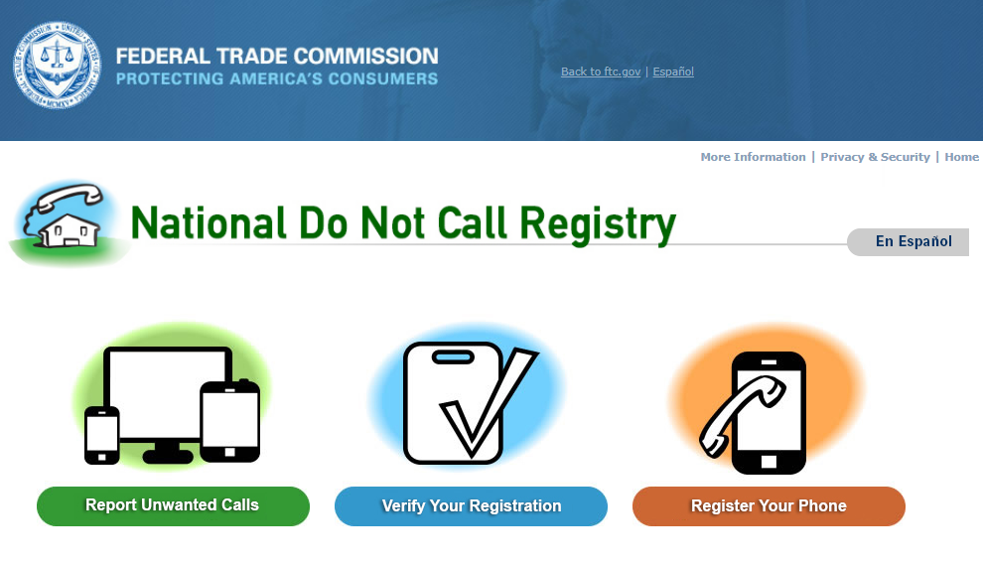
Federal Laws – TCPA
Telephone Consumer Protection Act
47 U.S.C. §227 et seq.
https://transition.fcc.gov/cgb/policy/TCPA-Rules.pdf
Regulates collection and use of e-mail addresses and telephone numbers
Implements “Do Not Call List”

Slide 22
Federal Laws - ECPA
Electronic Communications Privacy Act
18 U.S.C. § 2510
https://it.ojp.gov/PrivacyLiberty/authorities/statutes/1285
Regulate the interception of electronic communications, stored communications and certain types of tracking devices
Steve Jackson Games case
Law enforcement requires court order to access email and incoming/outgoing phone numbers
Revised as part of USA PATRIOT Act and more recently, but still criticized as out-of-date

Slide 23
Federal Laws – CFAA
Computer Fraud and Abuse Act
18 U.S.C. § 1030
http://fas.org/sgp/crs/misc/97-1025.pdf
Regulates computer tampering
Anti-hacking statute
Applies to any “federal interest computer” which includes any computer attached to the Internet, directly or indirectly
Morris worm one of the earliest cases
Popular tool by employers against hackers, former employees, etc.
Supreme Court case: Van Buren v. United States (2021)
Holding: An individual “exceeds authorized access” if they access computer with authorization but then access information in areas which are off-limits. Motivation behind the improper access is irrelevant.

Slide 24
More Federal Laws
Cable television data
Cable Communications Policy Act (Cable Act)
Driver’s information
Driver's Privacy Protection Act of 1994
USA PATRIOT Act
More to follow
Several bills reintroduced each year in Congress, but may not pass

Slide 25
State Laws – Overview
States have implemented a variety of privacy and security laws and regulations, some of which mirror federal laws and regulations, while the best known have broken new ground
Several, such as the security breach notification laws, have been copied around the country, but with different implementations making compliance more difficult for companies with data subjects in multiple states
https://www.ncsl.org/research/telecommunications-and-information-technology/state-laws-related-to-internet-privacy.aspx
According to the National Conference of State Legislatures:
In 2021, “at least 38 states introduced over 160 consumer privacy related bills” (vs. 30 states in 2020 and 25 in 2019)

Slide 26
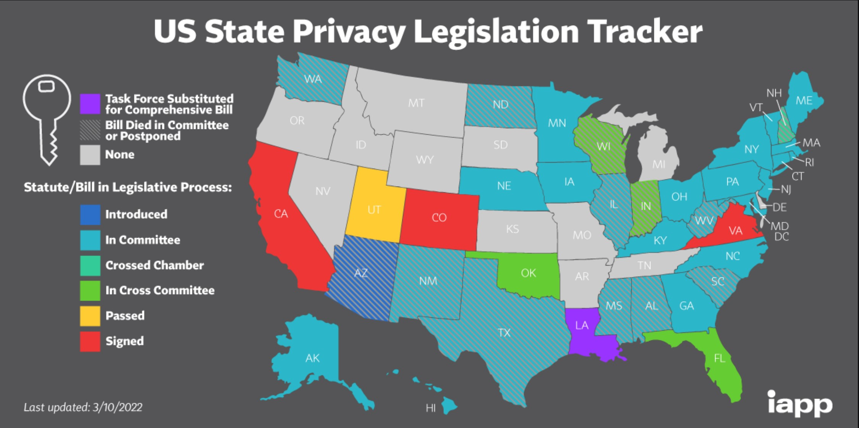
State Comprehensive Privacy Legislation
Currently: California, Colorado, and Virginia
Utah bill waiting for governor’s signature
States in yellow, blue, and green are pending
Source: https://iapp.org/resources/article/us-state-privacy-legislation-tracker/
Slide updated March 17, 2022

Slide 27
State Laws – Comprehensive Privacy Laws
California (CCPA (effective 2020-2022), CPRA (effective January 1, 2023))
Aimed at businesses which collect and sell large amounts of PII. Requires notice of collection, purpose, and sharing/selling. Data subjects can access and correct their PII. Potential of large fines.
So important that it gets its own slide…
Virginia (Virginia Consumer Data Protection Act, signed March 2, 2021, effective January 1, 2023)
Modeled on GDPR and CCPA. Applies more narrowly, but includes more individual rights than CCPA, and more limits on collection/use than CCPA.
Threshhold: businesses that control/process data of 100,000 VA consumers or from 25,000 consumers and derive 50% of gross revenue from sale of personal data.
Colorado (Colorado Privacy Act, signed July 8, 2021, effective July 1, 2023)
Similar to CCPA, but applies to consumers, not employees. Focuses on selling, not sharing. Violations considered “deceptive trade practice”. No exemption for non-profits. Law enforced by Attorney General and local district attorneys.
Threshhold: businesses that control/process data of 100,000 CO consumers or from 25,000 consumers and derive revenue from sale of personal data.
Utah (Utah Consumer Privacy Act, signed __?___, effective December 31, 2023)
Similar to CCPA, but important difference: only applies to sale of personal data for money, and permits disclosure of PII to third party if consumer could reasonably expect this.
More exemptions vs. CCPA.
But unlike CCPA, it specifically protects disclosure of trade secrets.
Threshhold: same as Virginia.

Slide 28
State Laws – California Consumer Privacy Act of 2018 (“CCPA”)
California Consumer Privacy Act
Cal. Civ. Code §§ 1798.100 et seq.
Touted as the state version of the GDPR, but actually a collection of greatest hits in privacy law for Cal. residents
Consumers may request a business to disclose:
Categories/types of personal data collected
Source of personal data
Business purpose for collecting the data
Consumers may require a business to:
Delete their personal data
Opt out of business’s sale of personal data
Not discriminate against consumers who opt out
All in addition to prior California’s other privacy laws, regulations

Slide 29

State Laws – CCPA Regulations
CCPA took effect January 1, 2020
AG began enforcement August 14, 2020.
Most recent regulations issued March 15, 2021
https://oag.ca.gov/sites/all/files/agweb/pdfs/privacy/ccpa-add-adm.pdf
Prescribes processes to implement the many regulations
Privacy statement required here and in other regs
Any business that sells personal data must have a “Do Not Sell My Personal Information” page (otherwise, the page is not required)
Language and page must be clear, easy to navigate. New optional icon.
If the business provides financial incentives to share personal data, then the business must specify those incentives
Businesses that sell data of over 100,000 consumers must post metrics for right-to-know requests
Businesses must evaluate and update their privacy statement at least once a year.
Notes:
The final regs removed the alternative option of having a “Do not sell my info” page, and reverted to the titled in the CCPA.

Slide 30
State Laws – California Privacy Rights Act
California Privacy Rights Act of 2020 (“CPRA”)
Takes effect January 1, 2023; enforcement begins July 1, 2023
Creates the California Privacy Protection Agency
Applies to any for-profit entity that:
does business in California
collects and uses the personal information of Californians &
(a) has annual gross revenues of at least $25 mm in the preceding calendar year, or
(b) buys, sells, or shares the personal information of at least 100,000 California residents or households, or
(c) derives at least 50% of its revenue from selling or sharing personal information
Adds “sharing” as equivalent to “selling” of personally-identifiable information

Slide 31
State Laws – CPRA
Also applies to service providers to a business covered by the CPRA and it collects or uses personal information as part of providing those services to the business, or if company buys personal information from a business or receives that information for cross-context behavioral advertising purposes
Modifies and extends CCPA
Still gives data subjects right to demand a business delete personal data, but business may refuse if personal data needed to ensure security and integrity in a necessary & proportionate manner
Data subject may request/demand correction of mistaken data
Data subject may still limit sale/sharing of personal data
Business may not retaliate against a data subject for opting out or exercising their rights

Slide 32

State Laws – Children's Online Privacy
California’s “Eraser” bill
“Privacy Rights for California Minors in the Digital World Act”, Calif. Bus. & Prof. Code §§ 22580-22582
Permits minors to remove, or to request and obtain removal of, content or information posted online
Prohibits online service directed to minors from marketing or advertising to minors specified products or services that minors are legally prohibited from buying
Prohibits marketing or advertising certain products (alcohol, cigarettes) based on personal information specific to minors
Delaware Online Privacy and Protection Act
Del. Code § 1204C
Websites, cloud service providers, and other
operators prohibited from marketing certain
products to children (alcohol, tobacco, etc.) and
cannot sell children’s personal information.
(Not) Joe Camel
Photo credit: Rex Walters, “Joe Camel Wannabe” at https://www.flickr.com/photos/wrex/154342987/, License: CC BY 2.0

Slide 33
State Laws – Biometric Privacy
Illinois: Biometric Information Privacy Act (“BIPA”) (2008)
Requires notice prior to collection of biometric data
Restrictions on disclosure to third parties
Data can’t be used for profit
Important: Individuals can sue to enforce
Illinois Supreme Court (2019): Proof of actual harm not required
Resulted in many lawsuits against employers using biometric time clocks and against social media companies
Other states: California, Washington, Virginia, Delaware, Arkansas, New York, Texas, Oregon
Approximately 20 additional states have introduced legislation
Summary: Businesses need to comply with biometric privacy requirements.

Slide 34
State Laws – Privacy Policies for Websites or Online Services
California laws (pre-CPPA, still in effect)
Do Not Track (Calif. Bus. & Prof. Code § 22575)
Requires the operator of a commercial web site or online service to disclose in its privacy policy how it responds to a web browser 'Do Not Track' signal, and requires operator to disclose whether third parties are or may be conducting such tracking on the operator’s site or service
CalOPPA (Calif. Bus. & Prof. Code §§ 22575-22578)
California's Online Privacy Protection Act requires an operator that collects personally identifiable information from California residents through an Internet Web site or online service for commercial purposes, to post a conspicuous privacy policy on its Web site or online service (which may include mobile apps) and to comply with that policy
Privacy policy must identify the categories of personally identifiable information that the operator collects about individual consumers who use or visit its Web site or online service and third parties with whom the operator may share the information
California Ed. Code § 99122
Requires private nonprofit or for-profit postsecondary educational institutions to post a social media privacy policy on the institution's Internet Web site
Connecticut (Conn. Gen. Stat. § 42-471)
Requires any person who collects Social Security numbers in the course of business to create a privacy protection policy
Policy must be "publicly displayed" by posting on a web page and the policy must (1) protect the confidentiality of Social Security numbers, (2) prohibit unlawful disclosure of Social Security numbers, and (3) limit access to Social Security numbers
Nevada (SB 220 eff. Oct. 1, 2019 and SB 260 eff. Oct. 1, 2021)
Similarities to CCPA but only provides right to notice, NOT right of access, modification, or deletion
Website and online service operators must post privacy policies; SB 260 added data brokers
SB 260 broadened consumer right to opt out (previously only permitted for PII sold to a third party for redistribution)
(Delaware and Oregon have similar laws)

Slide 35
State Laws – Privacy of Personal Information Held by Internet Service Providers
Maine Statutes 10 § 1348 et seq.
http://legislature.maine.gov/statutes/10/title10sec1348.html
Minnesota Statutes §§ 325M.01 to .09
Nevada Revised Statutes § 205.498
Maine, Minnesota, and Nevada require online providers to keep private customer information (no use/disclosure/sale), unless the customer gives permission
California Civil Code §§ 1798.83 to .84
Utah Code §§ 13-37-101, -102, -201, -202, -203
California and Utah require all nonfinancial businesses to disclose to customers, in writing or by electronic mail, the types of personal information the business shares with or sells to a third party for direct marketing purposes
Businesses may post a privacy statement that gives customers the opportunity to choose not to share information at no cost (no discounts/penalties)

Slide 36
State Laws - False and Misleading Statements in Website Privacy Policies
Nebraska Stat. § 87-302(14)
Deceptive trade practice to make a false or misleading statement in a privacy policy
Oregon (ORS § 646.607)
Unlawful trade practice to publish on website or in offline agreement incorrect statement/representation re: collection, use, disclosure, maintenance, and deletion of PII
Pennsylvania 18 Pa. C.S.A. § 4107(a)(10)
Prohibits false and misleading statements in privacy policies published on websites or otherwise distributed
Part of Pennsylvania’s deceptive or fraudulent business practices statute.

Slide 37
State Laws – Notice of Monitoring of Employee E-mail
Connecticut Gen. Stat.§ 31-48d
Employers who engage in any type of electronic monitoring must give prior written notice to all employees
If an employer has reasonable grounds to believe that employees are engaged in illegal conduct and electronic monitoring may produce evidence of this misconduct, the employer may conduct monitoring without giving prior written notice
Delaware Del. Code § 19-7-705
Prohibits employers from monitoring or intercepting electronic mail or Internet access or usage of an employee unless the employer has first given a one-time written or electronic notice to the employee.

Slide 38
State Laws – Employee Monitoring
Social Media
Over half of US states prohibit employers from requiring disclosure of information for social media or other personal online accounts, such as usernames, passwords, or content
Colorado Colo. Rev. Stat. § 24-72-204.5
Requires the state or any agency, institution, or political subdivision to adopt a written policy on any monitoring of electronic mail communications
Policy shall include a statement that correspondence of the employee in the form of electronic mail may be a public record under the public records law and subject to public inspection
Tennessee Tenn. Code § 10-7-512
Requires the state or any agency, institution, or political subdivision to adopt a written policy on any monitoring of electronic mail communications and the circumstances under which it will be conducted
Policy shall include a statement that correspondence of the employee in the form of electronic mail may be a public record under the public records law and may be subject to public inspection under this part
Notes:
https://www.nolo.com/legal-encyclopedia/state-laws-on-social-media-password-requests-by-employers.html#california

Slide 39
State Laws – Massachusetts (Written Information Security Program)
Massachusetts law requires a written information security program (“WISP”)
Requires encryption for “portable” personal information
Portable means online to and from website
Portable means laptops and smartphones
Portable means copies on portable media, thumb drives, etc.
Several businesses fined for not protecting customers’ personal information by Mass. A.G.’s office
http://www.mass.gov/courts/case-legal-res/law-lib/laws-by-subj/about/privacy.html
http://www.mass.gov/ocabr/docs/idtheft/201cmr1700reg.pdf

Slide 40
Takeaways – Legal Edition
US-based businesses may want to keep all personal information on servers physically located in U.S.
Make arrangements with cloud-based providers and hosts
Avoid cheap hosting outside the US
When in Rome…, get local counsel and a hosting service that understands local laws and regulations
While Congress may, eventually, pre-empt state laws regarding data privacy and security, continue to comply with the blizzard of states’ laws and regulations for the foreseeable future
Don’t collect any personal information you don’t need
Learn and comply with the many, many regulations
Encrypt, encrypt, encrypt!

Slide 41
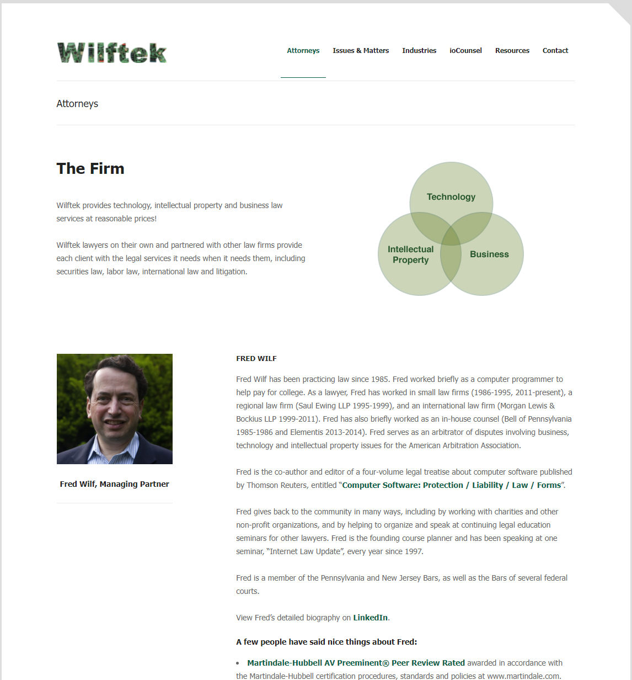
Questions?
Fred Wilf
Josh Waterston
Wilftek LLC
Ardmore, PA
wilftek.com
fred@wilftek.com
josh@wilftek.com
linkedin.com/in/fwilf
linkedin.com/in/joshwaterston/
linkedin.com/company/wilftek/

